Slide 1
SharePoint 2007 – Security, Profiles & Audiences
© 2007 Alexander Pajer

Slide 2
Agenda
Security Basics
Securing Ressources using the Object Model
User Profiles and Audiences

Slide 3
Security Basics

Slide 4



SharePoint Security Hierarchy
Top Level Site
Child Site
Site Collection

Slide 5
SharePoint Securables
Site Collection – Can define its own Security Principals
Site – Can inherit Security or define its own Security Principals
List / Library – Inherits Security Principals from Site
Item – Inherits Security Principals from Site

Slide 6




SharePoint Authentication
Top Level Site
Site
Site Collection
SharePoint Group
User / Group
Authentication Provider
Active Directory
ASP.NET Membership (Custom)

Slide 7
SharePoint Security
Remember „A-G-DL-P“ from File System
Import Users / Groups from Authentication Provider
Group in SharePoint using SharePoint Groups
Assign Permission Levels (e. g. „Design“) to Groups
If not defined otherwise Permission Levels are inherited

Slide 8
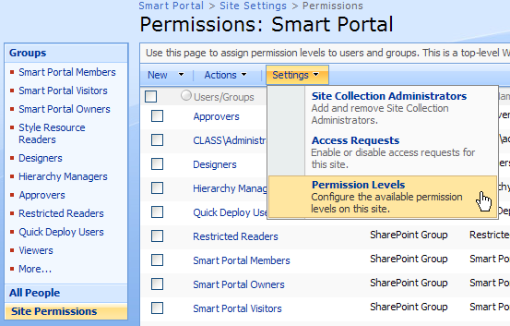
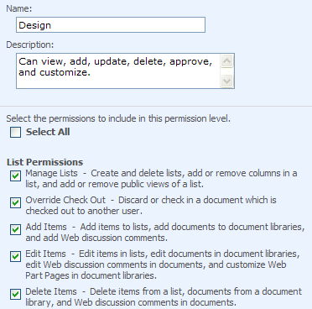
Permission Level
Permission Levels are Groupings of individual Permissions

Slide 9

Understanding Permission Levels
SharePoint Group
[Windows Group]
Assign
Permission Level: Custom PL
PL: Contribute
Manage Lists
Add Items
...
Permissions
...

Slide 10





SharePoint Zones
http://sharepoint
Intranet
http://extranet.company.at
Extranet
Top Level Site
Site
Authentication Provider

Slide 11
SharePoint Zones – Cont.
Zones enable you to have different Authentication Providers for ONE CONTENT
Zones use DIFFERENT Web Applicaitons to point to the SAME Content DB
Authentication Providers are defined in web.config
Windows Authentication
ASP.NET Membership – Allows Custom Providers

Slide 12
Security Basics
Importing Groups from Active Directory
Defining Permission Levels
Assigning Permission Levels to SharePoint Groups and Securing Ressources
Implementing Zones

Slide 13
Securing Ressources using the Object Model

Slide 14
SPUser
Represents a user in Microsoft Windows SharePoint Services
Use the "Add"-Methode to create the user
SPWeb web = SiteCol.AllWebs[“MySite”];
web.SiteUsers.Add ("class\\katja", "katja@class.local", "Katja“,
"a test user");
Katja.Name = "Katja";
Katja. [„E-Mail“] = „Katja@class.at";
Katja.Update();

Slide 15
Impersonate a User
In order to impersonate a user create an instance of the site collection using the users security token
// look up the users token
SPSite site = new SPSite("SiteCollection_Url"); SPWeb web = site.OpenWeb(); SPUser user = web.AllUsers["User_Name"]; SPUserToken token = user.UserToken;
// create an instance of the site colletion using the users token
SPSite impersonatedSiteCollection = new SPSite("SiteCollection_Url", token);

Slide 16
Code Elevation
To run code with elevated priveledges use the RunWithElevatedPrivileges method of SPSecurity which accepts a parameterless delegate.
// use global variables to pass parameters to the parameterless delegate
int x = 10;
SPSecurity.RunWithElevatedPrivileges(DoSomething);
public void DoSomething()
{
int y = x*2;
}

Slide 17
SPGroup
Represents a SharePoint Group on a SharePoint Web site
Method / Property
SPGroup.Users | Returns a Collection of Users
SPGroup.AddUser(SPUser) | Add a User to a Group
SPGroup.RemoveUser(SPUser) | Remove a User from a Group
SPGroup.AllowRequestToJoinLeave | Allows a User to Join / Leave a Group
SPGroup.ContainsCurrentUser | Evaluates if the current user is a member of that group

Slide 18
Setting Permission using Code
SPBasePermissions Enumeration
Specifies the built-in permissions available in Windows SharePoint Services – Find Details in MSDN
SPRoleDefinition
Represents a Permission Level in a Site
SPRoleAssignment
Defines the role assignments for a user or group on the current object
Holds a Set of Role Definitions
Securables contain a „RoleAssignments“-Collection

Slide 19
Setting Permission using Code – Cont.
SPRoleDefinition PermLevelFull= NewSite.RoleDefinitions["Full Control"];
SPRoleAssignment katjaAssignment = new SPRoleAssignment(Katja.LoginName, Katja.Email, Katja.Name, Katja.Notes);
// Bind Assignment to definition
KatjaAssignment.RoleDefinitionBindings.Add(PermLevelFull);
Lib.RoleAssignments.Add(katjaAssignment);

Slide 20
Demo
Creating Users
Creating Groups
Set Permissions on Securables

Slide 21
User Profiles and Audiences

Slide 22
UserProfileManager
A collection of UserProfile objects used to access user profile data
Method / Property
CreateUserProfile | Creates a User Profile
GetUserProfiles(AccountName) | Returns a specific User Profile
RemoveUserProfile(AccountName) | Remove a specific User Profile
UserProfileManager pm = new UserProfileManager(ServerContext.GetContext(site));
foreach (UserProfile profile in pm.)
{
…
}

Slide 23
UserProfile
Represents a user profile for a person in the user profile database.
Method / Property
profile[PropertyConstants.xxx]) | Access values of a certain profile
PersonalURL | Gets the URL of ther personale site of the profile
Colleagues | Gets colleagues of the person
GetManger() | Gets the manager of the person
CreatePersonalSite() | Creates a personal site
Commit() | Commits Changes

Slide 24
User Profile Samples
UserProfileManager pm = new UserProfileManager(ServerContext.GetContext(site));
//Create Bart's Profile
UserProfile p = pm.CreateUserProfile(@"class\bart");
//Set it's Office to Springfield
p[PropertyConstants.Office].Value = "Springfield";
p.Commit();
if (pm.GetUserProfile(@"class\bart")!=null)
{
pm.RemoveUserProfile(@"class\bart");
}

Slide 25
AudienceManager
Represents the entry point for the audience classes
Method / Property
Audiences | A collection of all Audiences
GetAudience(string) | Gets a specific Audience
IsMemberOfAudience(string, string) | Checks if a given user is member of a certain audience
AudienceManager am = new AudienceManager(ServerContext.GetContext(site));

Slide 26
Audience
The Audience class represents an audience on the portal site. It retrieves and updates audience information.
Method / Property
Commit() | Commits changes to audience data to the database.
GetMembership() | Gets an ArrayList of UserInfo objects that contain membership information for this audience.
AudienceRules | Gets a list of rules for this audience.
MemberShipCount | Gets the membership count for this audience.

Slide 27
Audience Code Sample
AudienceManager am = new AudienceManager(ServerContext.GetContext(site));
foreach (Audience a in am.Audiences)
{
Console.WriteLine("Audience: " + a.AudienceName);
}
Audience simpsons ;
try
{
simpsons = am.Audiences.Create("Springfield Users", "All users working in Springfield");
ArrayList audienceRules = new ArrayList();
AudienceRuleComponent arc = new AudienceRuleComponent("Office","Contains","Springfield");
audienceRules.Add(arc);
simpsons.AudienceRules = audienceRules;
simpsons.Commit();
}
catch (AudienceDuplicateNameException e)
{
simpsons = am.Audiences["Springfield Users"];
}

Slide 28
THANK YOU!!
ALEXANDER.PAJER@INTEGRATIONS.AT

